Slide 1
n = 1
Lachlan Mitchell

Slide 2
n = 1
3 Examples
Longitudinal Data
Multiple data streams
Single Data Stream
Known model
Unknown Model
Actual Change
Variability

Slide 3
n = 1
3 Examples
Longitudinal Data
Multiple data streams
Single Data Stream
Known model
Unknown Model
Actual Change
Variability

Slide 4
n = 1
3 Examples
Longitudinal Data
Multiple data streams
Single Data Stream
Known model
Unknown Model
Actual Change
Variability

Slide 5
n = 1
3 Examples
Longitudinal Data
Multiple data streams
Single Data Stream
Known model
Unknown Model
Actual Change
Variability

Slide 6
n = 1
3 Examples
Longitudinal Data
Multiple data streams
Single Data Stream
Known model
Unknown Model
Actual Change
Variability

Slide 7
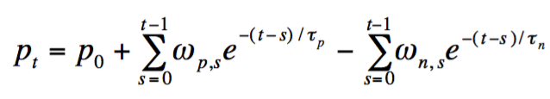
Multiple Data Streams - Known
Training Load - Performance
Banister Model
Impulse-Response

Slide 8
Impulse - Response

Slide 9
Impulse - Response

Slide 10
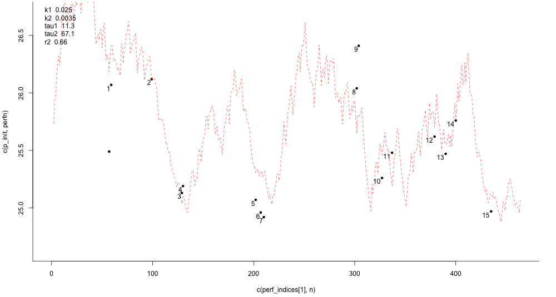

Slide 11
n = 1
3 Examples
Longitudinal Data
Multiple data streams
Single Data Stream
Known model
Unknown Model
Actual Change
Variability

Slide 12
n = 1
3 Examples
Longitudinal Data
Multiple data streams
Single Data Stream
Known model
Unknown Model
Actual Change
Variability

Slide 13
Multiple Data Streams - Unknown
Machine learning
Disclaimer – I am no expert!
A lot of potential in this area
Neural Networks

Slide 14
Neural Networks

Slide 15
Neural Networks
Each node has a weight and a bias. Like an intercept and a slope for a linear model.
Each node is ‘activated’ based on the sum of the response to the nodes behind it.

Slide 16
Neural Networks
Each node has a weight and a bias. Like an intercept and a slope for a linear model.
Each node is ‘activated’ based on the sum of the response to the nodes behind it.
Two options for output
Categorisation (Pictured)
Intensity (Continuous – This is the version I am using)

Slide 17
Multiple Data Streams - Unknown
Pros
Can analyse very complex, non-linear data sets
Cons
Need lots of data per node
Can easily overfit data
Can only learn data you’ve trained them on – may not deal with novel data very well

Slide 18
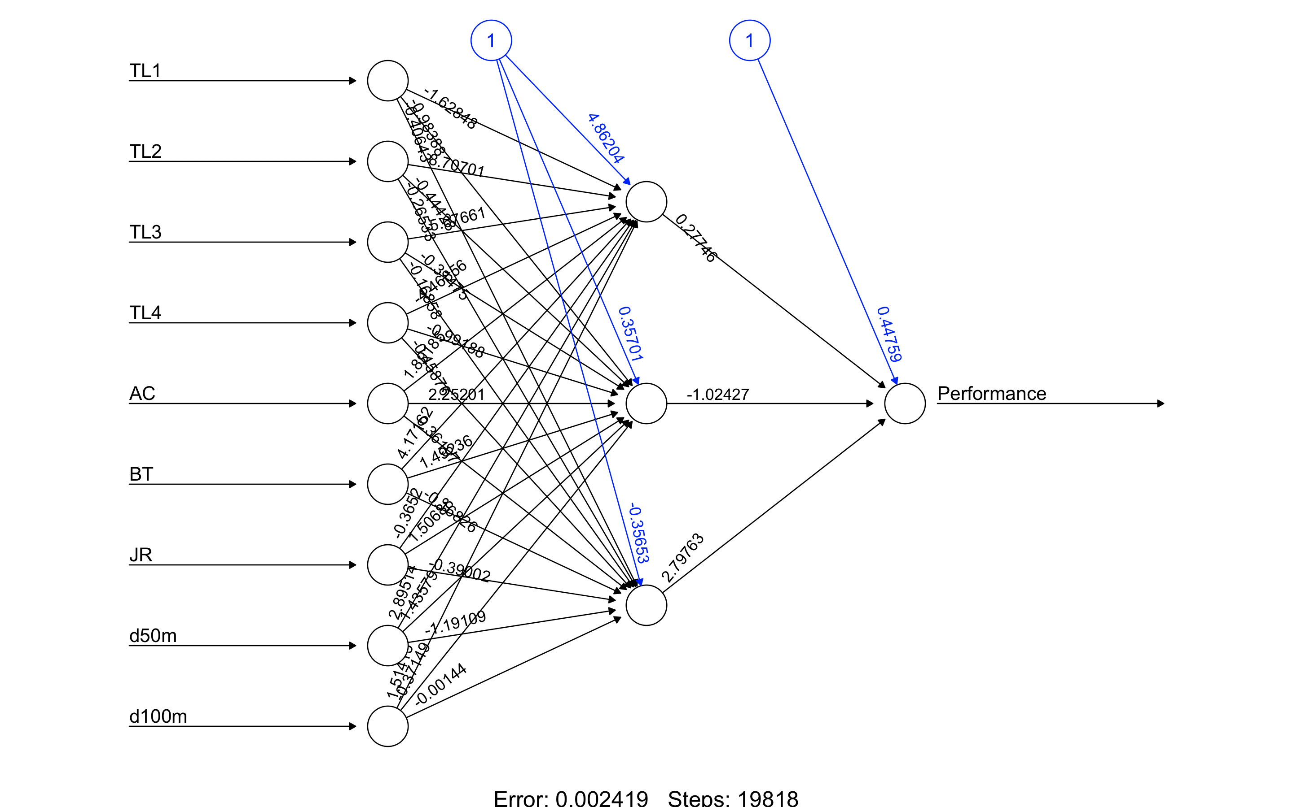
Multiple Data Streams - Unknown
1
2
3

Slide 19
Multiple Data Streams - Unknown
Bias
Training Load
Weight
1
Athlete
2
3
Distance

Slide 20
Multiple Data Streams - Unknown

Slide 21
Multiple Data Streams - Unknown

Slide 22
n = 1
3 Examples
Longitudinal Data
Multiple data streams
Single Data Stream
Known model
Unknown Model
Actual Change
Variability

Slide 23
n = 1
3 Examples
Longitudinal Data
Multiple data streams
Single Data Stream
Known model
Unknown Model
Actual Change
Variability

Slide 24
Variability Analysis
3x100 Submaximal HR Test
Calculate 100 m pace at 170 bpm
Track over time
Use effect sizes to interpret change
0.7 = Large effect
Flagged Recovered or Fatigued

Slide 25
3x100 Submax HR Test

Slide 26
3x100 Submax HR Test
Fatigue!
Recovery + Aerobic Development

Slide 27
n = 1
Longitudinal Data
Multiple data streams
Single Data Stream
Known model
Unknown Model
Actual Change
Variability

Slide 28
Thank you

